Slide 1

Prediction of Rainfall using Machine Learning
Name of the Student: Mr. Chelluboina Jyothi Swarup
Register Number: 39110220
Project Supervisor: C. M. Suja, M.S., Ph.d.,

Slide 2
Presentation Outline
Course Certificate
Introduction
Objectives
System Architecture / Ideation Map
Module Implementation
Application Snapshots
Results and Discussions
Conclusion & Future work
References

Slide 3
Course Certificate

Slide 4
Introduction
Rainfall is generally a significant issue across the world as it influences all the main consideration on which the individual is depended.
Rainfall is essential since this is the one with the highest correlation with adverse natural events such as landslides, flooding, mass movements and avalanches.
Timely and accurate predictions can help to proactively reduce human and financial loss.
Therefore, having an proper methodology for rainfall prediction makes it possible to take preventive and mitigation measures for these natural phenomena

Slide 5
Objectives
Train a Ensemble Learning model that can predict the rainfall based on the input features given to it.
The use of prevalent machine learning techniques to build models to predict whether it is going to rain tomorrow or not based on weather data.
This project is aimed to train a model for Rainfall dataset which predicts the forecast whether it rains tomorrow or not.
By understanding the features of dataset ,extracting relation between them cleaning it and finding necessary features that helps in prediction of rainfall and train the model using required parameters to get good accuracy from the model.

Slide 6
System Architecture / Ideation Map
Selection of dataset
Import dataset
Data pre-processing
Data analysis
Testing the model
Evaluating the model
Training the model
Model selection
Finalizing the model
Parameter tuning

Slide 7
Project Implementation
Selection of dataset with large data and proper labelled values
Software Requirements:
Installing Anaconda Individual edition 64-bit(PY 3.8)
Use Jupyter notebook in Anaconda Navigator for running project Python notebook.
Python Notebook also works in Google Colab, Kaggle Notebook editor
Hardware Requirements:
License: Free use and redistribution under the terms of the EULA for Anaconda Individual Edition.
Operating system: Windows 8 or newer, 64-bit macOS 10.13+, or Linux, including Ubuntu, RedHat, CentOS 7+, and others.
System architecture: Windows- 64-bit x86, 32-bit x86; MacOS- 64-bit x86; Linux- 64-bit x86, 64-bit aarch64 (AWS Graviton2 / arm64), 64-bit Power8/Power9, s390x (Linux on IBM Z & LinuxONE).
Minimum 5 GB disk space to download and install

Slide 8
Project Implementation(cont.)
Modules in Jupyter notebook
Visualization Libraries
matplotlib.pyplot
seaborn
ML model Algorithm
RandomForestClassifier
XGBClassifier
catboost
Data processing libraries
numpy
pandas
sklearn.model_selection
test_train_split
sklearn.preprocessing
LabelEncoder

Slide 9
Project Implementation
Performance metrics
sklearn.metrics
confusion_matrix
roc_auc_score
RocCurveDisplay
auc
roc_curve
precision_recall_fscore_support
plot_confusion_matrix
log_loss
accuracy_score
f1_score

Slide 10
Methodology
A Qualitative method has been used in the study. Various primary and secondary sources have been used. Literary sources like articles, journals have been used to substantiate the argument in the study.
Building a model needs a methodology to achieve good accuracy for the problem. We are following the bagging and boosting method, Random forest algorithm is based on bagging method which is based on decision tree algorithm and XGBoost and Catboost algorithms is based on boosting methods.
Random forest is made up of decision trees where we can set the number of decision trees built by the algorithm for predicting the result.

Slide 11
Methodology (cont.)
XGBoost and CatBoost is a decision-tree-based ensemble Machine Learning algorithm that uses a gradient boosting framework.
To use the algorithms we need a sci-kit learn(sklearn) module installed or imported in jupyter, google colab, Kaggle notebooks.
Generally, ML Algorithms are trained with 80% of the total dataset and the remaining 20% of data is used to test the model's performance. Here we are selecting the same 80%-20% formula followed by professionals.

Slide 12
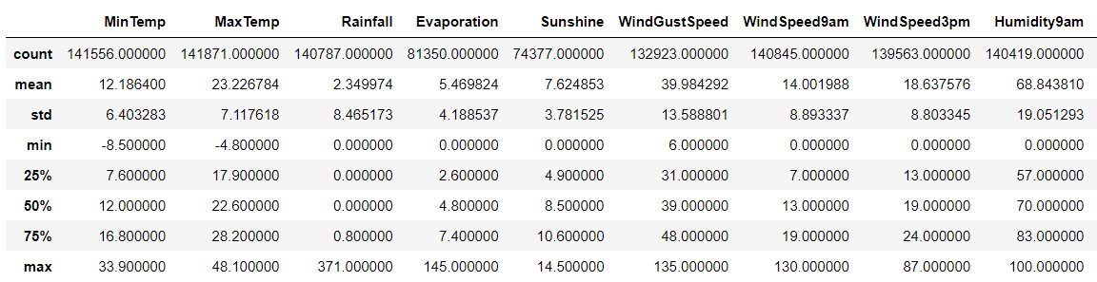
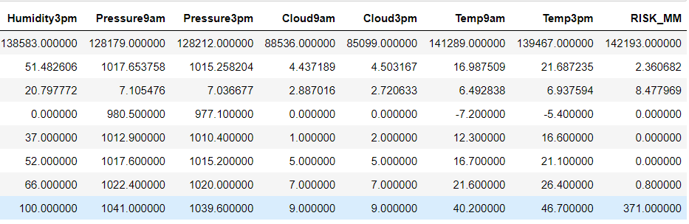
Results and Discussion
To understand the dataset, it is been represented via tables and graphs.
Description of dataset:

Slide 13
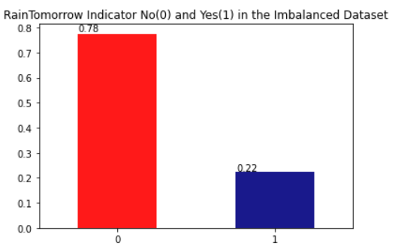
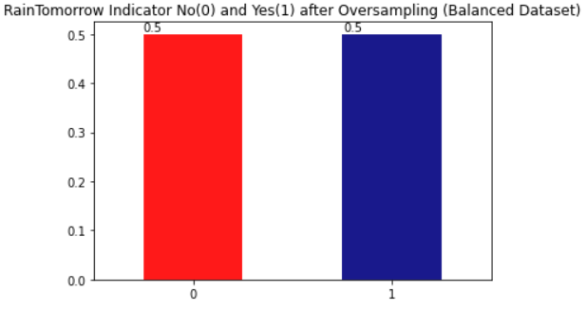
Results and Discussion
Visualizing the dataset whether it would rain tomorrow and resampling the imbalanced dataset.

Slide 14
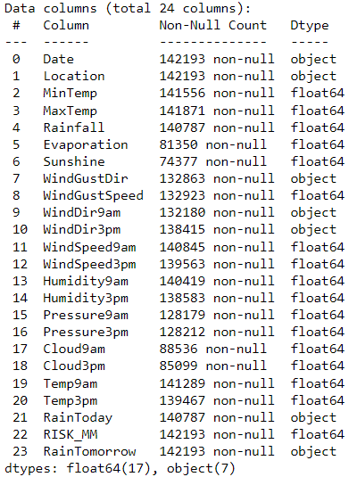
Results and Discussion
Features characteristics

Slide 15
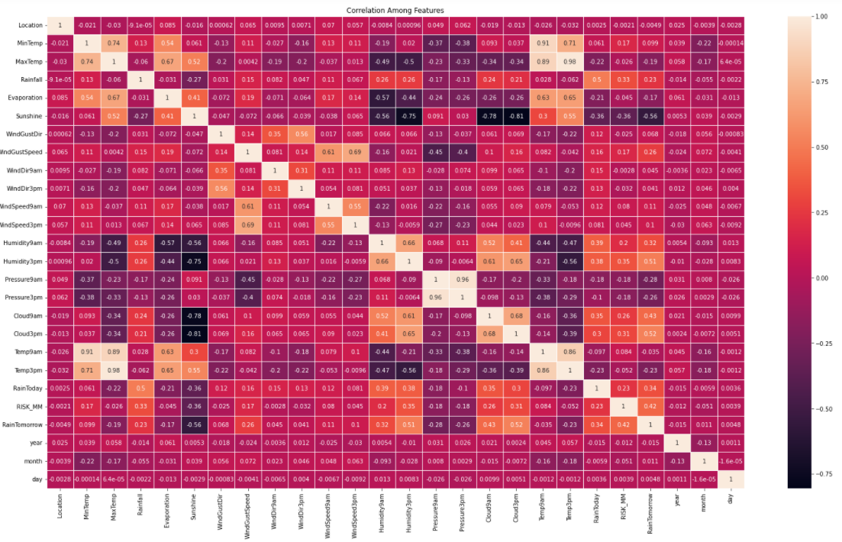
Results and Discussion
Correlation among features

Slide 16
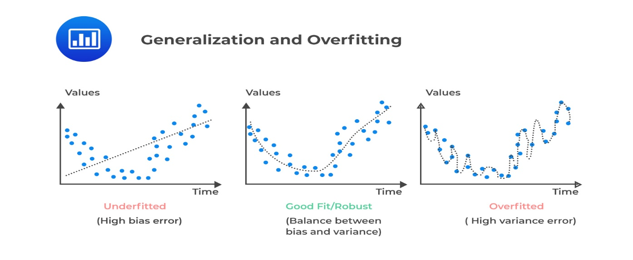
Results and Discussion
Model building:
Model needs to be trained and tested to get a good accuracy. the model is trained by considering the model complexity . We need our model to appropriate fit where it can go wrong in some values in prediction but gets right majority of the part of it.
Model complexity :
Model complexity is one of the factor that affects performance. Complexity of the model decides the overfitting, underfitting, appropriate fitting decisions made by model.

Slide 17

Results and Discussion
As mentioned in methodology, we are dividing the dataset into two parts, one containing of train dataset and other for testing the model that obtained.
By using RandomForest algorithm, we are developing the model.
Correspondingly, we are developing the models for XGBoost and CatBoost algorithm.
XGBoost Classifer
CatBoost Classifer

Slide 18
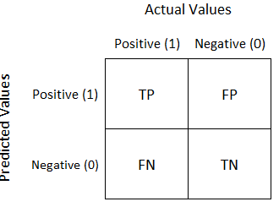
Results and Discussion
Confusion Matrix
A confusion matrix is a technique for summarizing the performance of a classification algorithm.
It is a Matrix with 4 different combinations of predicted and actual values

Slide 19
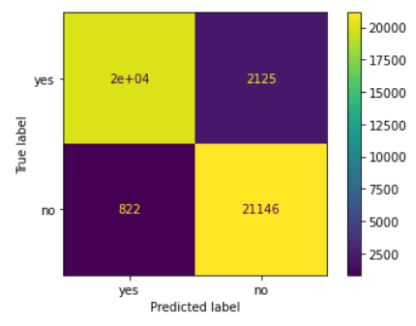
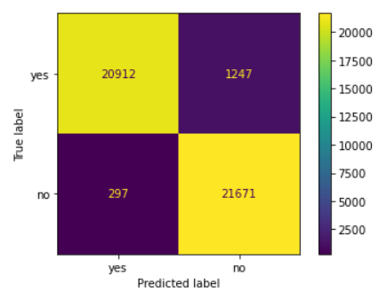
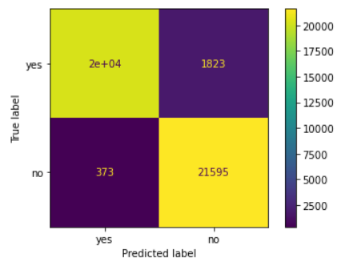
Results and Discussion
Confusion matrix of the models
RandomForest XGBoost CatBoost

Slide 20
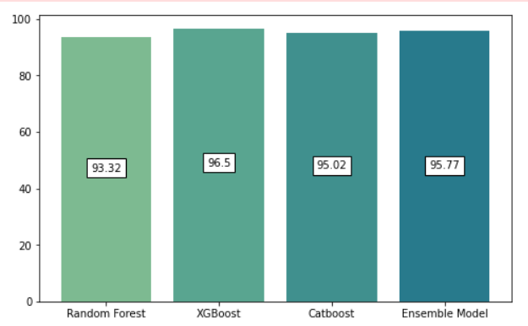
Results and Discussion
Ensemble learning:
Ensemble learning helps improve machine learning results by combining several models. This approach allows the production of better predictive performance compared to a single model.
For better performance of the model, we have used ensemble learning.
Final output:

Slide 21
Conclusion
We conclude that weather is uncertain and there is no such correlation among rainfall and the respective time. We figured certain patterns and relationships among data which helped in determining important features.
With these data analysis on rainfall data, we trained an ensembled model which includes three machine learning algorithms to predict the rainfall of tomorrow based on weather factors of today.

Slide 22
References
[1] 1.11. ensemble methods. scikit. (n.d.). Retrieved April 6, 2022, from https://scikit-learn.org/stable/modules/ensemble.html#bagging-meta-estimator
[2] 5. visualizations. scikit. (n.d.). Retrieved April 6, 2022, from https://scikit-learn.org/stable/visualizations.html
[3] The absolute basics for beginners¶. NumPy. (n.d.). Retrieved April 6, 2022, from https://numpy.org/doc/stable/user/absolute_beginners.html
[4] Matplotlib.pyplot¶. matplotlib.pyplot - Matplotlib 3.5.1 documentation. (n.d.). Retrieved April 6, 2022, from https://matplotlib.org/stable/api/_as_gen/matplotlib.pyplot.html
[5] Narkhede, S. (2021, June 15). Understanding confusion matrix. Medium. Retrieved April 6, 2022, from https://towardsdatascience.com/understanding-confusion-matrix-a9ad42dcfd62?gi=5109a2d7d068

Slide 23
References
[6] Sklearn.ensemble.randomforestclassifier. scikit. (n.d.). Retrieved April 6, 2022, from https://scikit-learn.org/stable/modules/generated/sklearn.ensemble.RandomForestClassifier.html
[7] XGBoost documentation¶. XGBoost Documentation - xgboost 1.5.2 documentation. (n.d.). Retrieved April 7, 2022, from https://xgboost.readthedocs.io/en/stable/
[8] CatBoost: CatBoost categorical features. Analytics Vidhya. (2020, June 7). Retrieved April 7, 2022, from https://www.analyticsvidhya.com/blog/2017/08/catboost-automated-categorical-data/
[9] Sklearn.preprocessing.LabelEncoder. scikit. (n.d.). Retrieved April 7, 2022, from https://scikit-learn.org/stable/modules/generated/sklearn.preprocessing.LabelEncoder.html
[10] Sklearn.impute.IterativeImputer. scikit. (n.d.). Retrieved April 7, 2022, from https://scikit-learn.org/stable/modules/generated/sklearn.impute.IterativeImputer.html

